Slide 1
ULCHS Office of Sponsored Research Services (OSRS)
University of Liberia College of Health Sciences
Notes:
EDMUND
Greetings everyone!
We’re happy to be here with you today representing the ULCHS Office of Sponsored Research Services.
(connect with the audience – based on context; potentially ask for a show of hands on who has heard of the OSRS?)

Slide 2
OSRS Mission & Vision
Mission: Supporting translational, biomedical, and health research and training activities to improve the health, economic, and social well-being of humanity.
Vision: To improve healthcare delivery in Liberia through the advancement of health and biomedical research, teaching, and learning.
ULCHS
Notes:
EDMUND
Mission: Supporting translational, biomedical, and health research and training activities to improve the health, economic, and social well-being of humanity.
Vision: To improve healthcare delivery in Liberia through the advancement of health and biomedical research, teaching, and learning.

Slide 3
OSRS Objectives
To enhance the effectiveness of ULCHS’s activities through:
identification of research funding opportunities
pre-award assistance in the development of research proposals,
post-award administration of research grants and contracts, supporting basic, clinical, and translational health research in Liberia
training ULCHS faculty, staff and students on relevant pre- and post-award skills
ULCHS
Notes:
JOSEPHINE
Objectives: To enhance the effectiveness of ULCHS’s activities through:
identification of research funding opportunities
pre-award assistance in the development of research proposals,
post-award administration of research grants and contracts, supporting basic, clinical, and translational health research in Liberia
training ULCHS faculty, staff and students on relevant pre- and post-award skills

Slide 4
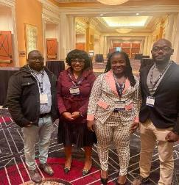
OSRS Background
Office officially opened in June 2021
OSRS team participated in extensive grant management training with Vanderbilt University Medical Center, highlighting pre- and post-award grant and research administration areas.
Training encompassed ~5 months of hybrid learning both virtually and in-person with continued mentoring support from Yale University.
ULCHS OSRS is now a member of the Society of Research Administrators International and the Grant Administration International Network.
ULCHS
Notes:
EDMUND
The OSRS office officially opened in June 2021 and operates within the ULCHS as a Research Administration Office
OSRS team participated in extensive grant management training with Vanderbilt University Medical Center, highlighting pre- and post-award grant and research administration areas.
Training encompassed ~5 months of hybrid learning both virtually and in-person.
ULCHS OSRS is now a member of the Society of Research Administrators International and the Grant Administration International Network

Slide 5
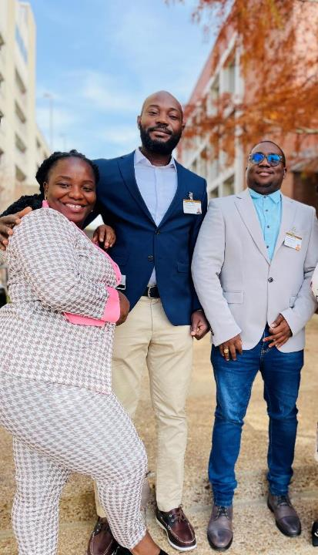
OSRS Team
Team member (from right) | Years of Experience
Director, OSRS – Edmund G. Manston, MBA in Finance | >10
Pre-Award Officer – Konkun Wleh, BBA in Accounting | >10
Post-Award Officer – Josephine T. Theoway, BBA in Accounting | >8
ULCHS
Notes:
EDMUND
Here you have our full OSRS team.
In the photo from right, you see the OSRS Director, Mr. Edmund Manston, the Pre-award Office, Mr. Emmanuel Togba, and the Post-award Officer, Ms. Josephine Theoway.

Slide 6
ULCHS Gap Analysis
General Partner Information
Organizational background details
Pre-award Support & Systems
Proposal preparation
Policies & procedures
Post-award Support & Systems
17 areas re: award mgmt & donor compliance
Team Management
Communication
Staff development
4 key sections of
231-item Needs Assessment survey
(conducted by outside partner)
ULCHS
Notes:
JOSEPHINE
Last year one of our BRIDGE-U partners conducted a 231- question Needs Assessment survey (completed by various ULCHS team members) to gauge where things stand in relation to research and grant administration capabilities.
Based on those results, a Gap Analysis Report was recently drafted which outlines existing strengths of ULCHS as well as areas that needs improvement within the 4 key areas of the assessment:
General Partner Information
Pre-award Support & Systems
Post-award Support & Systems
Team Management
We’re pleased to report that overall, ULCHS already excelled or had sufficient results in 66% of the defined assessment areas, 24% had low priority issues, and only 10% of items had high priority gaps that we’re already addressing.
The team is already working on measures to address the high priority gaps identified in the report, and we look forward making our office as strong as it can be. The first of which includes a formal Single Audit that is underway with an external auditor.
*Gap analysis report results available upon request.

Slide 7
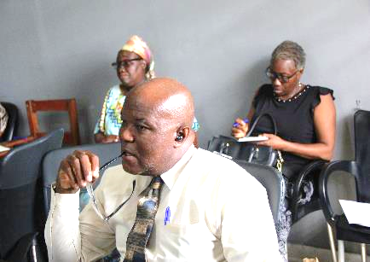
ULCHS Gap Analysis
ULCHS Leadership team assigned to high-priority gaps identified.
Capacity building tracker created to assess progress on each item from one quarter to the next.
Team has already reduced the amount of high-priority gaps from 10% to 6% with all items continually being addressed and resolved.
Bi-annual progress reports available.
ULCHS
Notes:
JOSEPHINE
Last year one of our BRIDGE-U partners conducted a 231- question Needs Assessment survey (completed by various ULCHS team members) to gauge where things stand in relation to research and grant administration capabilities.
Based on those results, a Gap Analysis Report was recently drafted which outlines existing strengths of ULCHS as well as areas that needs improvement within the 4 key areas of the assessment:
General Partner Information
Pre-award Support & Systems
Post-award Support & Systems
Team Management
We’re pleased to report that overall, ULCHS already excelled or had sufficient results in 66% of the defined assessment areas, 24% had low priority issues, and only 10% of items had high priority gaps that we’re already addressing.
The team is already working on measures to address the high priority gaps identified in the report, and we look forward making our office as strong as it can be. The first of which includes a formal Single Audit that is underway with an external auditor.
*Gap analysis report results available upon request.

Slide 8
OFS Key Portfolio Updates (as of November 2022)
Total Portfolio Value:
$13,432,167.27
ULCHS
Notes:
EDMUND
Barbara and the OFS team shared this slide already in their presentation, but we share it again here to note that our team is already involved in the management of several active grants, and we supported the application/ contracting process for some of the newer funding as well.
As you may have noted, the ULCHS’s total grant portfolio in terms of value as of November 9, 2022, is US$13,432,167.27.
This amount includes both active grants and anticipated funding through awards received but not yet obligated as well as one grant that recently closed.
As you can see here in the bright green section, 59% of that total portfolio lies in active grant funding currently obligated to ULCHS.

Slide 9
Portfolio
As of November 2022, ULCHS has received 16 subawards funded by:
EDCTP
1 award
$523,767 (6%)
WB
1 award
$444,000 (5%)
NIH
3 awards
$294,187 (4%)
USAID
6 awards
$6.54M (77%)
1 award - $28,375
Autonomous
Autonomous
Autonomous
2 awards - $265,812
under tri. agmts.
CEPI
1 award
$244,375 (3%)
BMGF
1 award
$131,830 (2%)
Irish Aid
1 award
$207,929 2%)
Sabin
1 award $35,019.54 (.4%)
CDC
1 award
$47,007 (0.6%)
2 awards - $5.13M
Autonomous
4 awards - $1.41M
under tri. agmts.
Autonomous
Autonomous
Autonomous
Autonomous
under tri. agmts.
ULCHS
Notes:
EDMUND
As mentioned, our portfolio includes the donors listed here.
$ figures here are active/committed funds, and everything in blue represents funds subcontracted directly to ULCHS (and the red sections indicate where a third-party entity was in place).

Slide 10
ULCHS Subaward Sponsors (as of November 2022)
National Academy of Sciences
International AIDS Vaccine Initiative
WHO (Expired)
The Power of Nutrition
Sabin Vaccine Institute
Boston University
Kwame Nkrumah University of Science and Technology
University of Hawaii
Yale University
University of North Carolina Chapel Hill
Vanderbilt University Medical Center
University of California San Francisco
University of Massachusetts
University of Michigan
Sabin Vaccine Institute
ULCHS
Notes:
EDMUND
We have experience with a wide swath of international subaward sponsors which includes a range from academic institutions to public and private organizations.

Slide 11
OSRS Pre-award Admin Services
Disseminate funding opportunities
Build compliant budgets
Assist with proposal administrative and compliance matters, referring legal matters to UL’s legal team
Conduct a final compliance review
Facilitate university approval
Submit proposals
ULCHS
Notes:
KONKUN

Slide 12
OSRS Proposal Submission Process
Find funding & distribute details
PI works with OSRS to develop submission timeline & budget
OSRS will review your documents for compliance
OSRS submits e proposal on behalf of ULCHS
PI confirms eligibility & contacts OSRS for support
ULCHS
Notes:
KONKUN

Slide 13
OSRS Pre-award Best Practices for PI’s
Notify OSRS before applying or collaborating on a Sponsored Research Project by submitting a Research Project Intent Notification Form (RPINF) as soon possible in the process.
Allow OSRS to help you develop your budget in line with ULCHS effort accounting system and funder’s guidelines.
Complete a biographical sketch/biosketch, CV, and Other Support documents (depending on the funding agency) and submit it to OSRS.
Share any pre-award assessment questionnaire(s) or teaming agreements/letter of intent from collaborating partners with OSRS/OFS.
ULCHS
Notes:
KONKUN

Slide 14
Research Project Intent Notification Form (RPINF)
PROJECT NUMBER (to be filled by OSRS Staff)
PROJECT TYPE
PROJECT TITLE
PROJECT GOAL
PRINCIPAL INVESTIGATOR (PI) | Name and SURNAME | Email and Phone Number
CO-PRINCIPAL INVESTIGATORS | Name and SURNAME | Email and Phone Number
 | Name and SURNAME | Email and Phone Number
1.Wıll the project involve human subject? | ☐YES ☐ NO
2. What is the expected duration of the project?
3. Which donor will the proposal be submitted to?
4. When is the deadline for the Call for Proposal? If apply.
PROJECT INVESTIGATORS*
Name and Surname | Nationality | Role | FTE %** | Signature
ULCHS
Notes:
KONKUN

Slide 15
Sample Biosketch
OMB No. 0925-0001 and 0925-0002 (Rev. 10/2021 Approved Through 09/30/2024)
BIOGRAPHICAL SKETCH
Provide the following information for the Senior/key personnel and other significant contributors. Follow this format for each person. DO NOT EXCEED FIVE PAGES.
NAME:
eRA COMMONS USER NAME (credential, e.g., agency login):
POSITION TITLE:
EDUCATION/TRAINING (Begin with baccalaureate or other initial professional education, such as nursing, include postdoctoral training and residency training if applicable. Add/delete rows as necessary.)
INSTITUTION AND LOCATION | DEGREE (if applicable) | Completion Date MM/YYYY | FIELD OF STUDY
A. Personal Statement B. Positions, Scientific Appointments, and Honors C. Contributions to Science
ULCHS
Notes:
KONKUN
So we just want to put on everyone’s radar that as you go through the grant application writing and submission process, there may be complicated documents required that our office can help with.
You may or may not have heard of a biosketch form at this point – and that’s fine – but it has a prescribed way to complete it, and we can be helpful in training on this.

Slide 16
OSRS Post-award Admin Services
Seek prior approvals from the sponsor
Serve as liaison between the PI and sponsor
Ensure funds are expended in compliance with the award/sub-award agreement as well as relevant laws
Navigate the process of budget revisions
Complete closeout documents
ULCHS
Notes:
JOSEPHINE
Prior approval is required for an award recipient to add or change a foreign component under a grant to a domestic or foreign award.

Slide 17
OSRS Post-award Best Practices for PI’s
Contact OSRS in the event a potential funder sends you any type of agreement to sign - Don’t sign anything on behalf of ULCHS
Participate in new routine all-projects meetings
Share project-related research with OSRS
Comply with OSRS project field visits for programmatic compliance when applicable
ULCHS
Notes:
JOSEPHINE

Slide 18
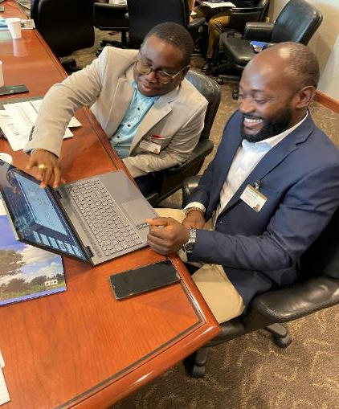
OSRS next steps
Initiate bi-monthly training for ULCHS faculty
Continue to develop Standard Operating Procedures to improve efficiency and ensure quality output within the ULCHS research administration systems
Foster collaboration and network with partners for grant submission and other future initiatives
Launch the first edition of the OSRS Newsletter to spread the word about available services and support
Contact: ulchs_osrs@ul.edu.lr
ULCHS
Notes:
EDMUND

Slide 19
OSRS contacts
OFFICE: ulchs_osrs@ul.edu.lr
Pre-award services: wlehko@ul.edu.lr (0886322912)
Post-award services: theowayjt@ul.edu.lr (0776631523)
Director: manstoneg@ul.edu.lr (0770135309)
ULCHS
Notes:
EDMUND

